Slide 1


Spark Interview Questions Window Function in Spark

Slide 2
Window Function in SPARK
Window functions are functions that perform a calculation over a group of records and produces return value for every record in the group.
In other words, when executed, a window function computes a value for each and every row in a window(group of records) .
Window functions allow users of Spark SQL to calculate results such as the rank of a given row or a moving average over a range of input rows.
Window functions significantly improve the expressiveness of Spark’s SQL and DataFrame APIs

Slide 3
Why Window Function in SPARK
There were two kinds of functions supported by Spark SQL that could be used to calculate a single return value :
First, built-in functions, such as substr or round, take values from a single row as input, and they generate a single return value for every input row.
Second, Aggregate functions, such as SUM or MAX, operate on a group of rows and calculate a single return value for every group.
Windows functions caters the third scenario, which is the combination of above two cases ,here it is operated on the group of rows but produces the single return value for very input row.
Example : Calculating the Rank of the rows in the group of records.

Slide 4
Window Function Details
Frame or Window : window function calculates a return value for every input row of a table based on a group of rows, called the Frame or Window.
Every input row can have a unique frame associated with it. This characteristic of window functions makes them more powerful to express various data in a concise way processing tasks.
Spark SQL supports three kinds of window functions:
ranking functions
analytic functions
aggregate functions

Slide 5
Window Function in SPARK
Ranking Function | Function
 | rank
 | dense_rank
 | percent_rank
 | ntile
 | row_number
Analytic Function | cume_dist
 | first_value
 | last_value
 | lag
 | lead
Aggregate Function | sum, avg, min, max and count.

Slide 6
To use window functions, needs to mark that a function is used as a window function by using the OVER clause
Adding an OVER clause after a supported function, example:
scala> dataset.withColumn(“dense_rank_result", dense_rank over windowSpec)
scala> dataset.withColumn(“sum_result", sum(column_name) over windowSpec)

Slide 7
Under stand Window function syntax
id | bucket
0 | 0
1 | 0
2 | 0
3 | 1
4 | 1
5 | 1
6 | 2
7 | 2
8 | 2
//create data set
val dataset = spark.range(9).withColumn("bucket", 'id % 3)
val windowSpec = Window.partitionBy('bucket).orderBy('id)
scala> dataset.withColumn("cume_dist_result",
cume_dist over windowSpec).show
Note : WindowSpec is a window specification that defines which rows are included in a window (frame),

Slide 8
WindowSpec Window specification
WindowSpec is a window specification that defines which rows are included in a window (frame)
val windowSpec = Window.partitionBy(‘data_column’).orderBy(‘id’)
Window Specification includes three parts:
Partition specification defines which records are in the same partition. With no partition defined, all records belong to a single partition.
Ordering Specification defines how records in a partition are ordered that in turn defines the position of a record in a partition. The ordering could be ascending or descending.
Frame Specification which defines the rows to be included in the frame for the current row, based on their relative position to the current row. For example, "the three rows preceding the current row to the -→ current row" describes a frame including the current input row and three rows appearing before the current row

Slide 9
Under stand Window function syntax
id | bucket
0 | 0
1 | 0
2 | 0
3 | 1
4 | 1
5 | 1
6 | 2
7 | 2
8 | 2
//create data set
val dataset = spark.range(9).withColumn("bucket", 'id % 3)
val windowSpec = Window.partitionBy('bucket).orderBy('id)
scala> dataset.withColumn("cume_dist_result",
cume_dist over windowSpec).show
Note : WindowSpec is a window specification that defines which rows are included in a window (frame),

Slide 10
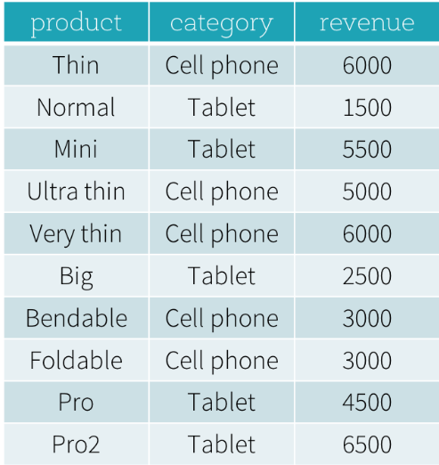
Window Function Usecase Example
Suppose that we have a productRevenue table :
What are the best-selling and the second
best-selling products in every category?
What is the difference between the revenue
of each product and the revenue of the
best-selling product in the same category
of that product?

Slide 11
First Question solution without Window function
SELECT
product,
category,
revenue
FROM (
SELECT
product,
category,
revenue,
dense_rank() OVER (PARTITION BY category ORDER BY revenue DESC) as rank
FROM productRevenue) tmp
WHERE
rank <= 2

Slide 12
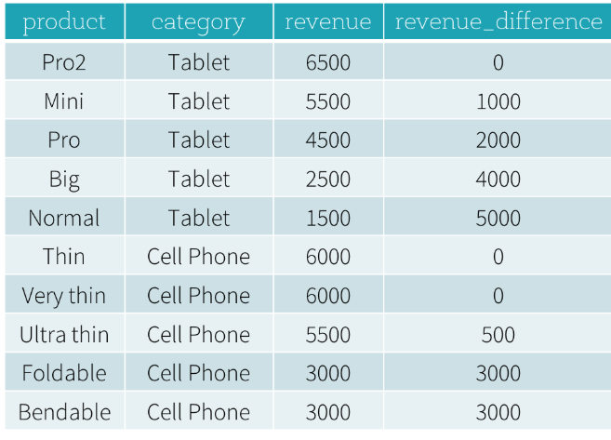
First Question solution with Window function
import sys
from pyspark.sql.window import Window
import pyspark.sql.functions as func
windowSpec = \
Window
.partitionBy(df['category']) \
.orderBy(df['revenue'].desc()) \
.rangeBetween(-sys.maxsize, sys.maxsize)
dataFrame = sqlContext.table("productRevenue")
revenue_difference = \
(func.max(dataFrame['revenue']).over(windowSpec) - dataFrame['revenue'])
dataFrame.select(
dataFrame['product'],
dataFrame['category'],
dataFrame['revenue'],
revenue_difference.alias("revenue_difference"))

Slide 13
Thanks for watching and do subscribe to the channel

